Slide 1
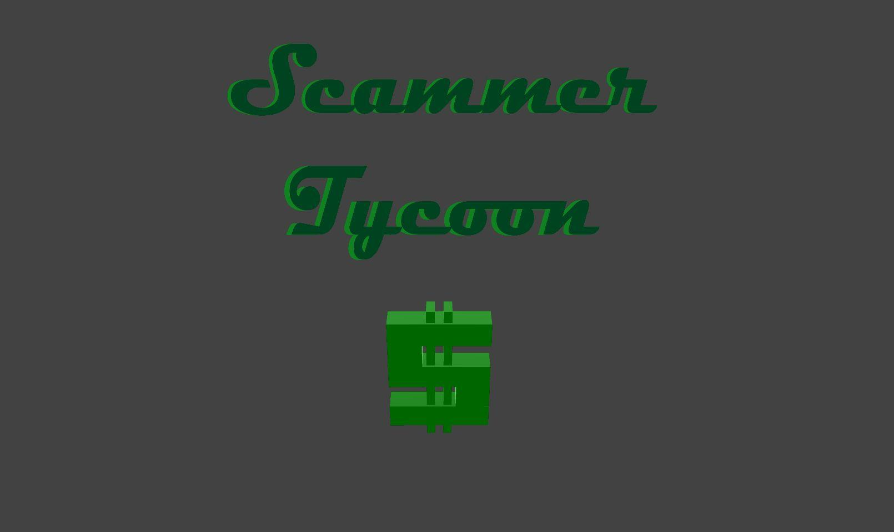
Winston
Ethan Huang
Jerryl
Ethan Heng
Group 5

Slide 2
Theme and idea
Scamming has been part of life for as long as barter trade existed. Only being widespread when media and remote communications became common.
Inspired by Tech Support: Error Unknown, and set in a scam call centre, we planned to create a tycoon type game.

Slide 3

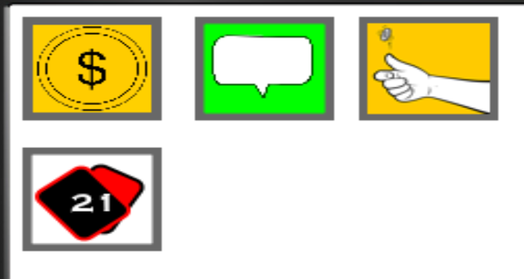
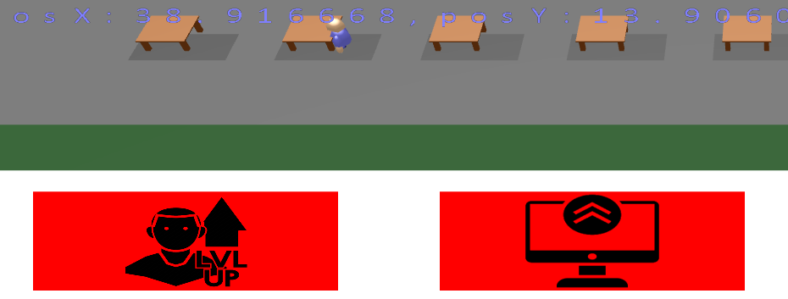

GDD’s mechanics
1st proposed mechanic: buying workstations and people to work for you - jerryl
2nd proposed mechanic: police meter, for time based risk - ethan huang
3rd proposed mechanic: permanent upgrades - ethan heng
4th proposed mechanic: minigames to earn and lost money - winston

Slide 4



Workstations/Workers Mechanics
Hire/Upgrade Workers and Workstations using the buttons
Higher tier Worker earns more money and causes Police Gauge to increase slower but has higher wage
Higher Workstations help Workers earn more money, but is more expensive to upgrade
Both Worker and Workstations are required to earn passive income
Tier 1
Tier 2
Tier 3

Slide 5


Police-meter
When the meter fills up, the game ends and the player gets arrested by the police.
How it increases? The more workers you have, the faster it fills up(depends on your workers’ quality too)
How it decreases? You can pay money to bribe the cops but each time you do it, the next time will be more expensive and the chance of the bribe succeeding will also decrease.

Slide 6
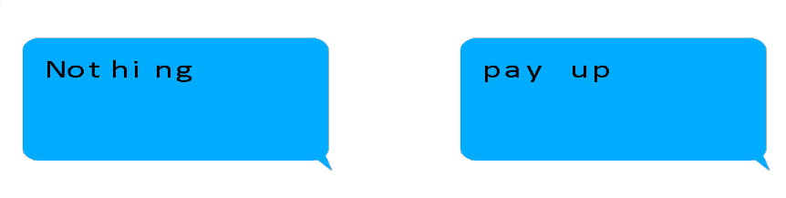
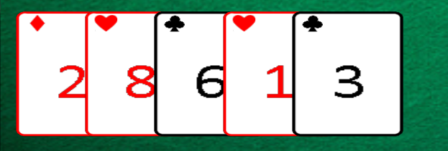
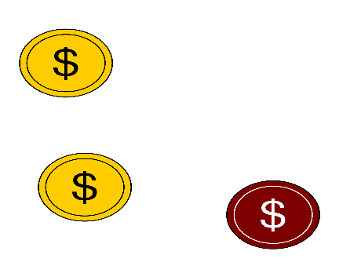
PC mechanics
Game 1: click on coins and avoid the bombs
Game 2: there will be a text message given, player will have to choose the right answers to the text to try to scam the victim and earn money
Game 3: a simple coin flip for a 50/50 gamble to earn money
Game 4: players will bet some money to play blackjack against an AI and winning gives the player 100% profit

Slide 7
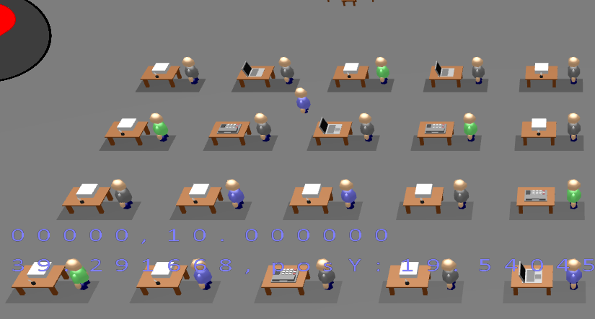
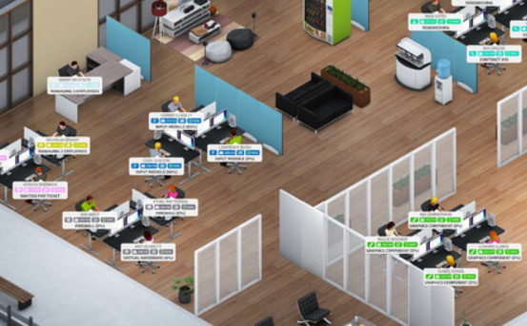
Visual Style
Low poly => reduces geometry complexity and shows consistency between objs, as all objs has the same low poly look, even the downloaded ones
Dull => emphasize the shady/low quality building
Inspired by Startup Company & Prison Architect

Slide 8
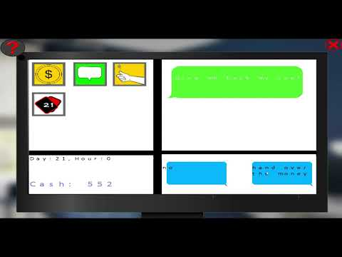

Slide 9
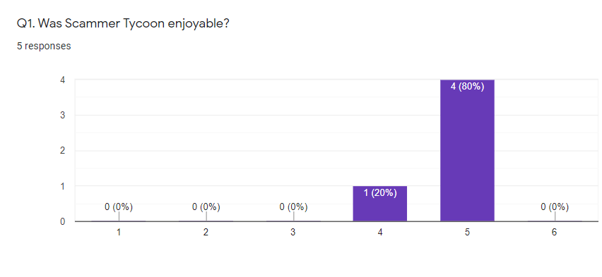
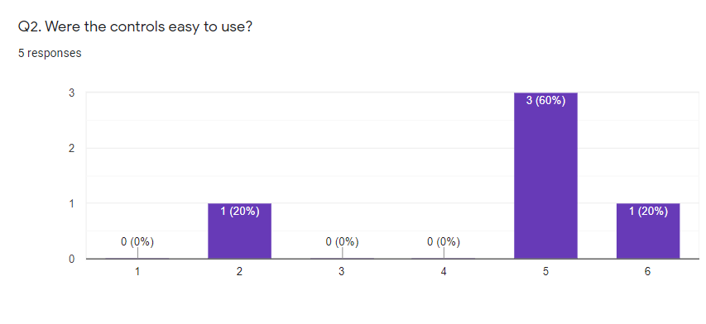
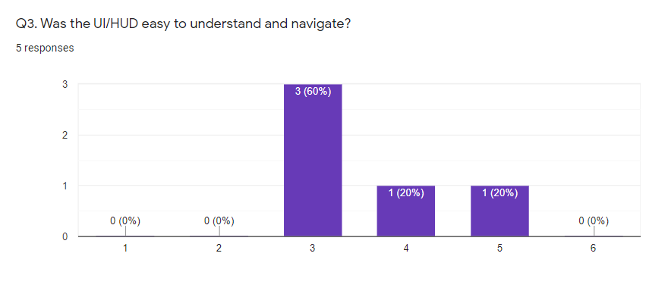
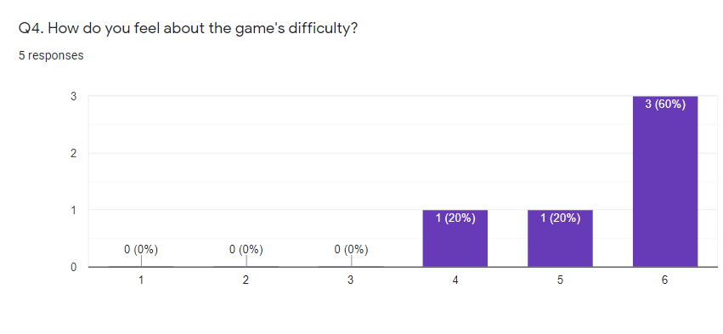
Playtest Survey Results

Slide 10
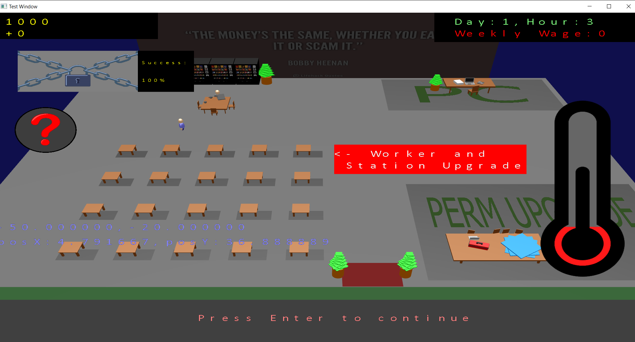
Playtest Survey Results(How we reacted)
UI was hard to navigate => added a help button for both the game and the PC minigame
game was too easy => increased cost for base upgrades and added wages(weekly deduction of money)
Game was a bit boring/lacklustre => added blackjack for fourth minigame

Slide 11
Tasklist
Jerryl | Main Menu | HUD | Tutorial | End Screen
Ethan Huang | Models | Police-meter | Other designs | Game trailer
Ethan Heng | PC screen UI | Aiming game | Text game | Coin toss bet game | Black Jack design
Winston | Entity upgrades | Movement & collision | Black Jack logic | Black Jack design

Slide 12
Links
GDD - https://docs.google.com/document/d/1itWoOF_502mhRmOhwqeWjsGzJ-ltwsGr216hGynWQKY/edit
Trello - https://trello.com/b/7filxqXT/sp2idk

